Slide 1
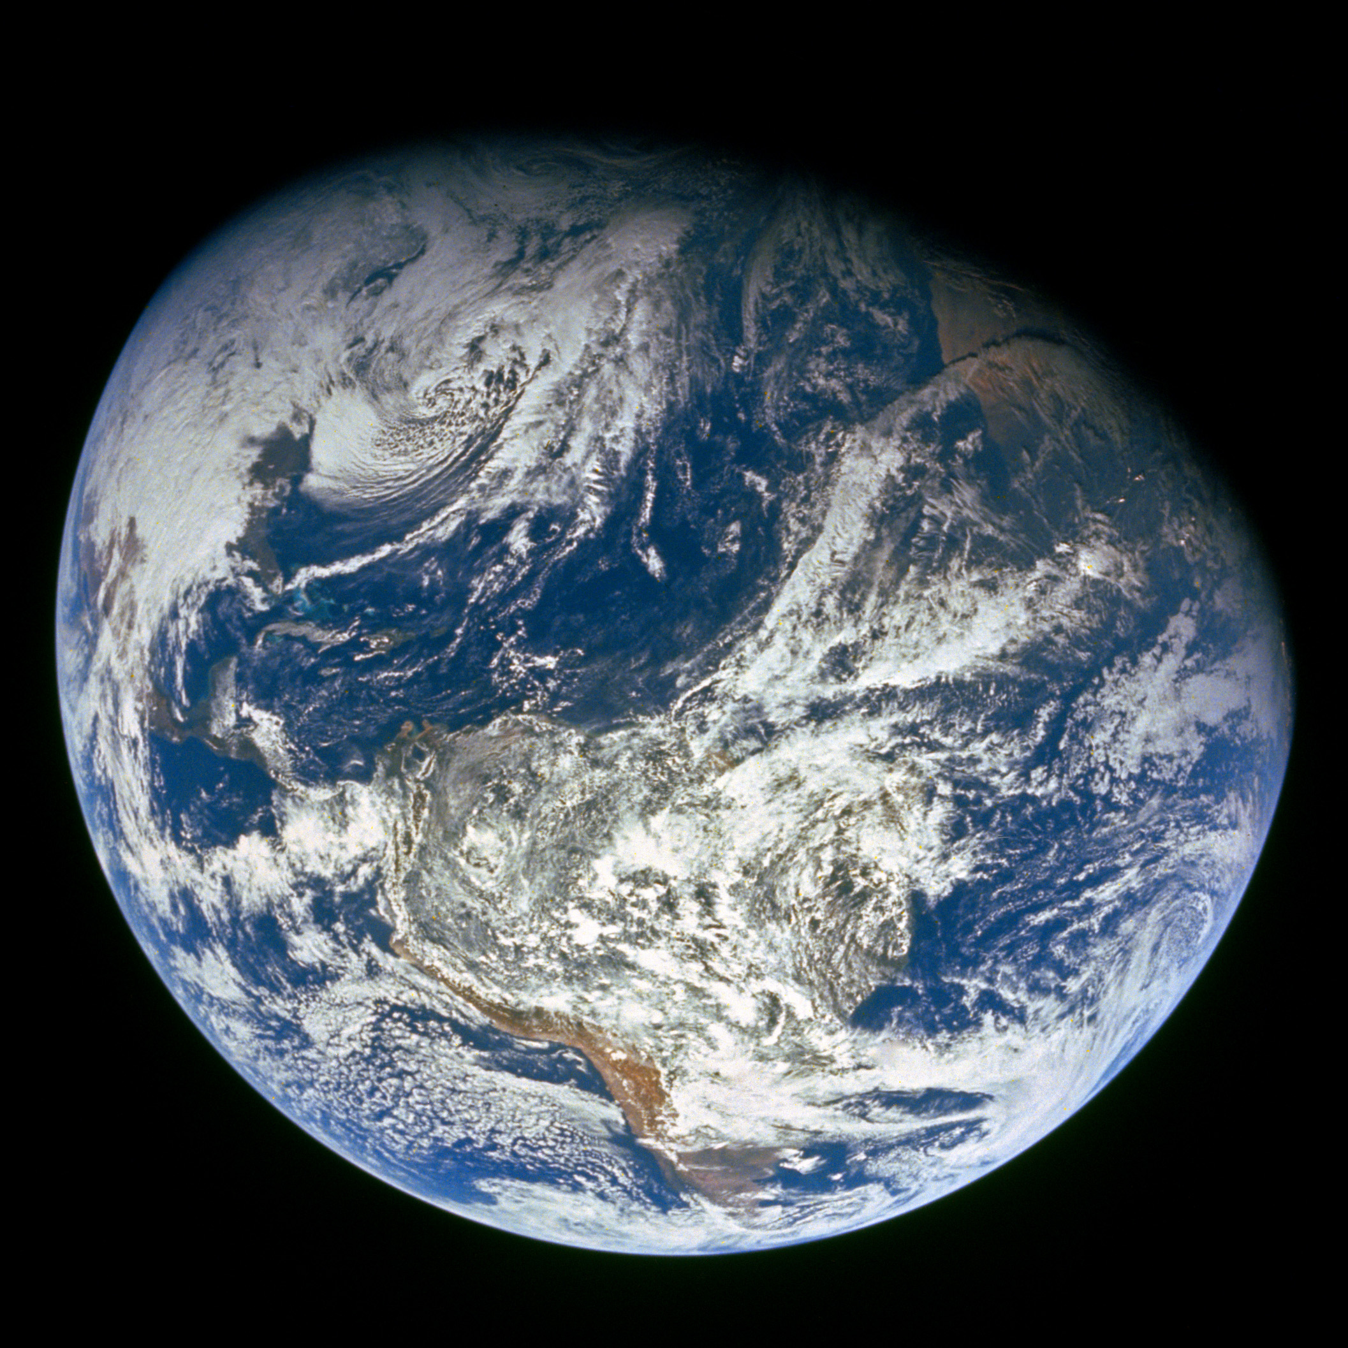
GENESIS
”In the beginning God…”

Slide 2
Review

Slide 3
Four year study of the Bible - 17 Periods
1)
2)
3)
4)
5)
6)
7)
8)
9)
Genesis
10)
11)
12)
13)
14)
15)
16)
17)
Divided Kingdom
Judah Alone
Captivity
Return From Captivity
Years Of Silence
Life Of Christ
The Early Church
The Letters To The Christians
Before The Flood
The Flood
The Scattering Of The People
The Patriarchs
The Exodus
The Wandering In The Wilderness
Invasion & Conquest
Judges
United Kingdom

Slide 4
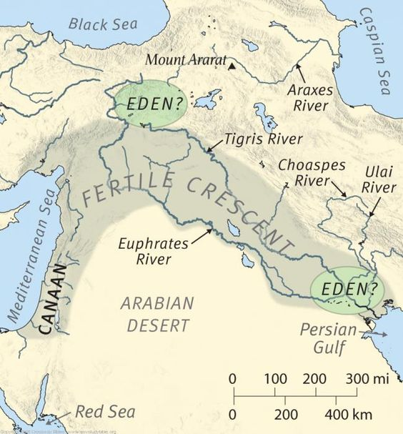
One river flowed out of Eden to water the garden. From there it divided into 4 rivers:
[1] Pishon
[2] Gihon
[3] Tigris
[4] Euphrates

Slide 5
Man was created in the “image of God”
Eph 4:22-24 “to put off your old self, which belongs to your former manner of life and is corrupt through deceitful desires, and to be renewed in the spirit of your minds, and to put on the new self, created after the likeness of God in true righteousness and holiness.”

Slide 6
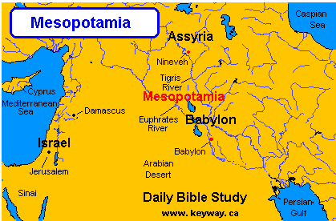
Haran
Canaan
Ur

Slide 7
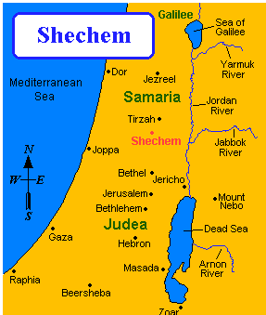
Canaan

Slide 8
Abraham’s Journey
11:31 Ur
11:31 Haran
12:6 Shechem, as far as the terebinth tree of Moreh
12:8 Between Bethel and AI
12:9 “toward the South”
12:10 Egypt
13:1 “the South” – Negev
13:3 Back between Bethel and AI
13:8 Terebinth trees of Mamre, which are in Hebron
14:13 Terebinth trees of Mamre the Amorite
18:1 Terebinth trees of Mamre

Slide 9
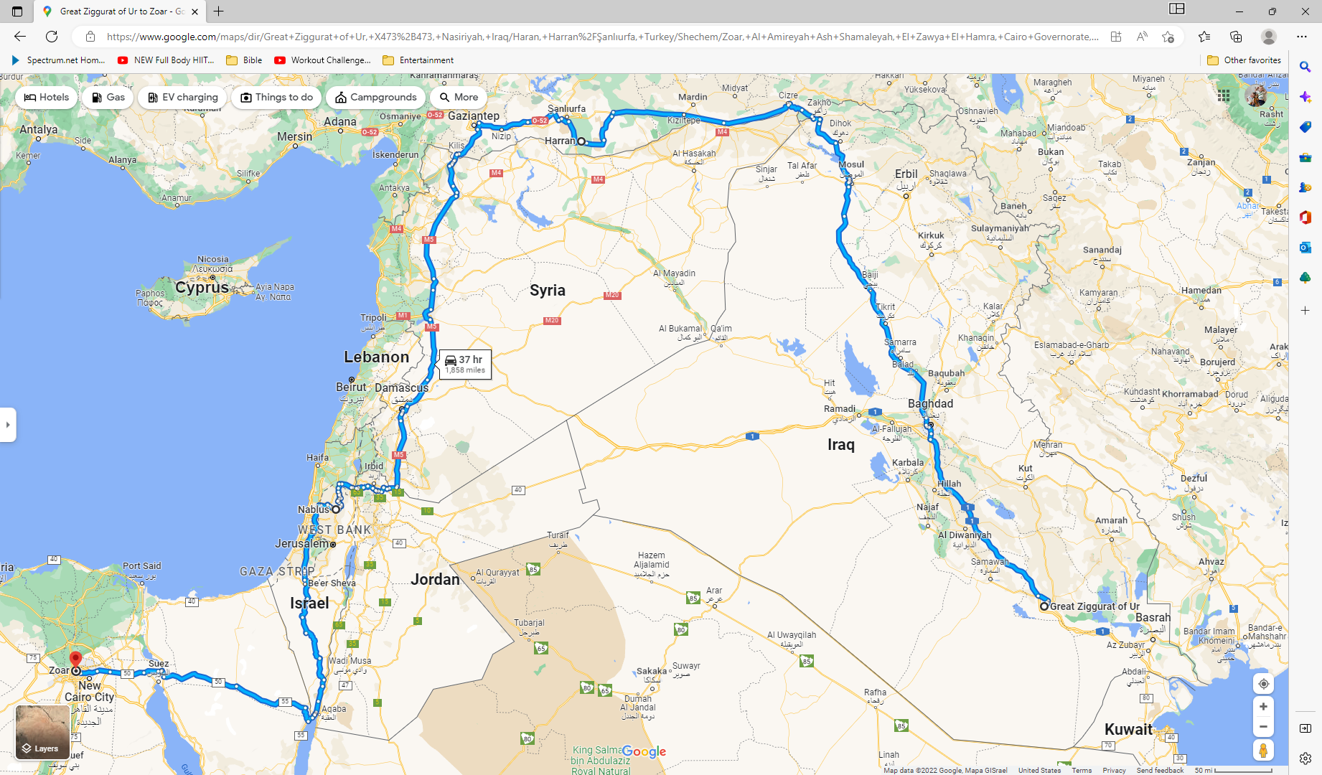
Notes:
Iraq, Turkey, Syria, Jordan, Israel, Egypt

Slide 10
God’s Promises to Abram
In Haran
12:2 Nation
12:3 All nations blessed through him
12:6 Shechem, terebinth tree of Moreh
12:7 Land
Between Bethel and AI
13:15 Land
13:16 Nation

Slide 11
Today’s Lesson - Genesis 15-17

Slide 12
Context
Who?
God
Abram/Abraham
Sarai/Sarah
Hagar
Ishmael
When?
“Patriarchs” – 17 Periods
At start, Abram is between 75 and 85 years old
Where?
Terebinth trees of Mamre (Hebron), Shur

Slide 13
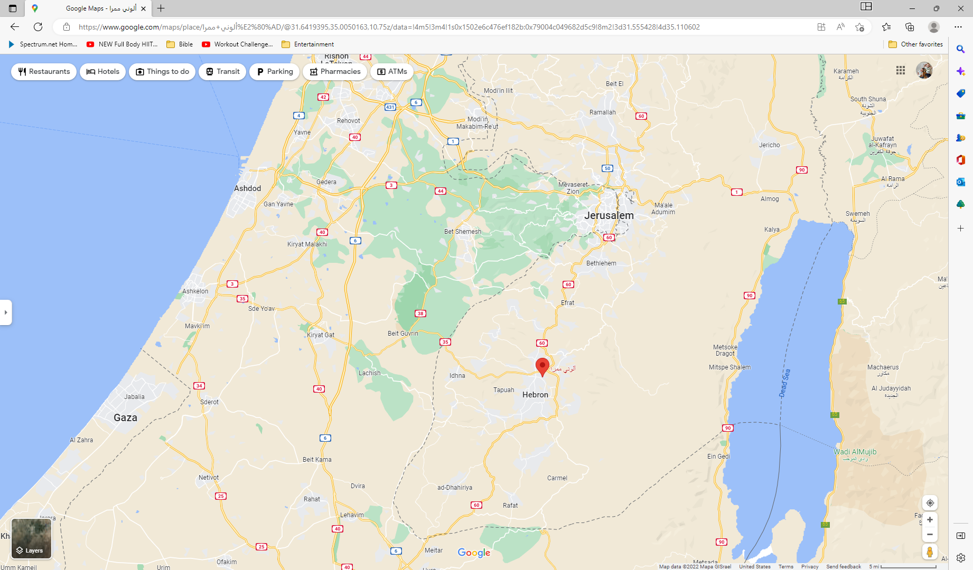
Notes:
Red Dot is Hebron

Slide 14
Today’s Outline
God restates the nation and land promises (twice)
Ishmael
The Covenant

Slide 15
God restates the nation and land promises
“Do not be afraid, Abram. I am your shield, and your exceedingly great reward”
Nation Promise
God said Abram’s descendants would be like the stars in that you could not number them
“And he believed in the Lord, and He accounted it to him for righteousness.” 15:6 Rom 4:3 Gal 3:6 James 2:23
Land Promise
God told Abram that He had brought Abram from Ur to give him the land
Abram asked God how he would know he would inherit it

Slide 16
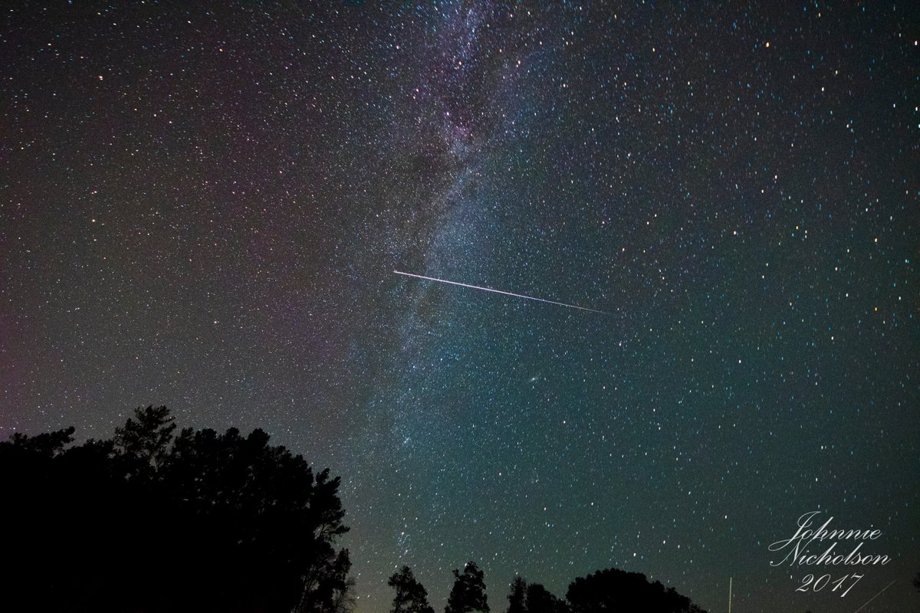
Notes:
Johnnie Nicholson‏
@thekyniche
Follow Follow @thekyniche
More
@lucky13wxman @RyanBeesleyFox5 @BeckePhysics @sudbri @VirtualAstro @jginfla @spann ISS Piercing the Milky Way

Slide 17
God Answers Abram’s Question
3 year old heifer, 3 year old female goat, 3 year old ram, turtledove, and a young pigeon
Deep Sleep, Horror and Great Darkness
Descendants 400 years as strangers and slaves
4rth Generation Would Return to Canaan
“a smoking oven and a burning torch that passed between those pieces”
Covenant - They would inherit from the River of Egypt to the Euphrates – all the land of the “ites”

Slide 18
Ishmael
Sarai and Abram (seemingly) try to help God
Hagar becomes pregnant and “despised” Sarai
To regard with contempt or scorn.
To dislike intensely; loathe.
To look down upon with disfavor or contempt; to contemn; to scorn; to disdain; to have a low opinion or contemptuous dislike of
Sarai told Abram “My wrong be upon You!”
Abram said “Indeed your maid is in your hand; do to her as you please.”
Sarai dealt harshly with Hagar

Slide 19
Ishmael
Hagar Runs Away (on the way to Shur)
Angel appears to Hagar and tells her:
Return to Sarai and submit to her
Her baby (Ishmael) will be a great nation
Ishmael would “dwell in the presence of all his brethren”

Slide 20
Ishmael
God Hears
Gen 16:11 You shall call his name Ishmael, Because the Lord has heard your affliction
God Sees
Gen 16:13 Then she called the name of the Lord who spoke to her, You-Are-the-God-Who-Sees; for she said, “Have I also here seen Him who sees me?”

Slide 21
Ishmael
Hagar Returns and Ishmael is born
Abram is 86 when Ishmael is born

Slide 22
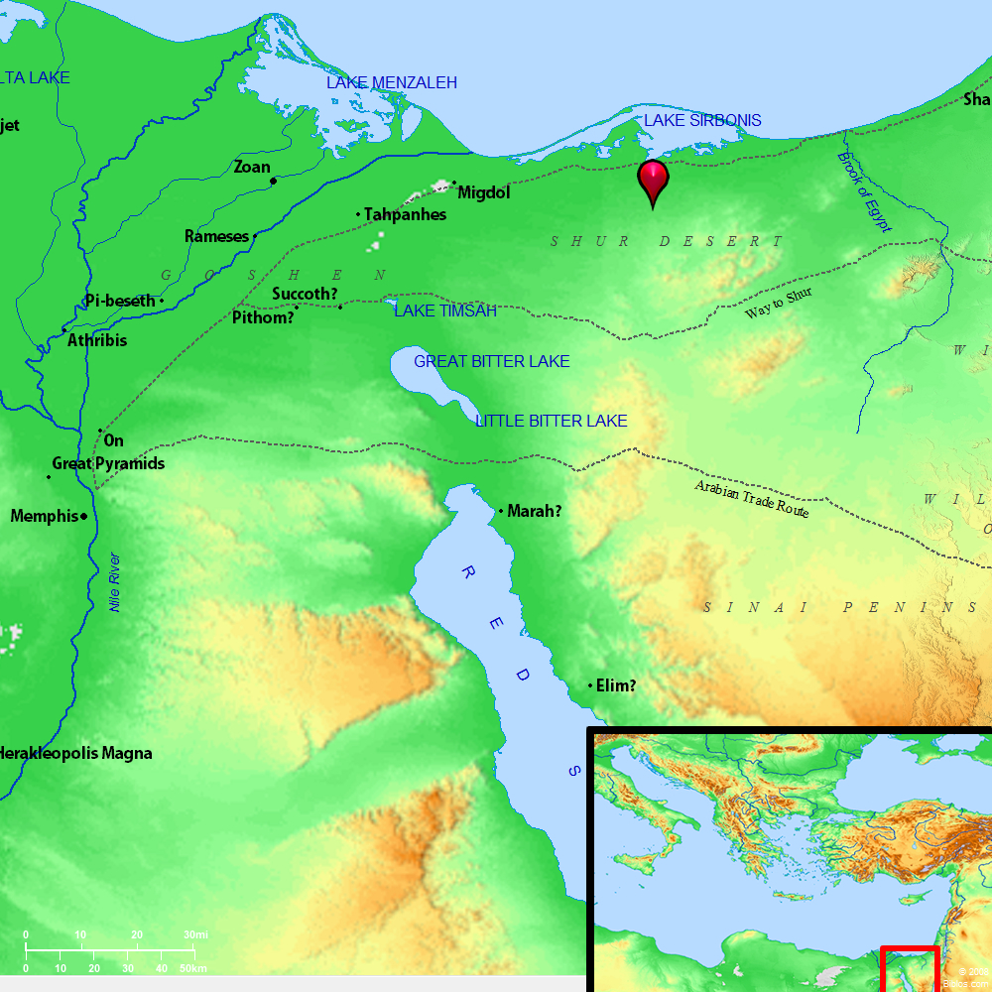
From BibleAtlas.org
Notes:
Red Dot is Hebron

Slide 23
The Covenant - Abram Gets New Name
Abram was 99 years old
“I am Almighty God; walk before Me and be blameless. And I will make My covenant between Me and you, and will multiply you exceedingly.”
Then Abram fell on his face
God changed Abram’s name to Abraham because he was going to be the father of many nations
Covenant between God and Abraham and Abraham’s descendants
God would be Abraham and his descendant’s God

Slide 24
The Covenant - Circumcision
God restated the nation and land promise
God instituted circumcision as part of His covenant with Abraham

Slide 25
The Covenant - Sarai Get New Name
God changed Sarai’s name to Sarah because she was going to be the mother of many nations

Slide 26
The Covenant - Isaac is Promised
Sarah would have a son (Isaac)
Abraham wanted God to consider Ishmael
God’s covenant would be through Isaac
God would bless Ishmael
Multiply Exceedingly
12 Princes
Great Nation
Abraham circumcised all the males of the house

Slide 27
Summary and Application

Slide 28
Summary and Application
God keeps His promises on His own timetable
II Peter 3:8
But, beloved, do not forget this one thing, that with the Lord one day is as a thousand years, and a thousand years as one day.
God doesn’t need our help to keep His promises
”I am your shield, your exceedingly great reward”
Ps 3:3
But You, O Lord, are a shield for me, My glory and the One who lifts up my head.

Slide 29
Follow-Up

Slide 30
God’s Promises to Abram
In Haran
12:2 Nation
12:3 All nations blessed through him
12:6 Shechem, terebinth tree of Moreh
12:7 Land
Between Bethel and AI
13:15 Land
13:16 Nation

Slide 31
God’s Promises to Abram
Hebron, Terebinth trees of Mamre
15:5 Nation
15:7 Land
15:18 Land – from the river of Egypt to the great river
17:2 Nation – multiply you exceedingly
17:4-6 Nation (father of MANY nations)
17:8 Land
17:16 Sarah a mother of Nations; Kings of peoples shall be from her
17:19 God’s covenant would be with Isaac
17:20 Ishmael would be a great nation, 12 princes

Slide 32
Terebinth Tree
Oak? Pistachio?
Gen 35:1-4 Jacob hid all the foreign gods and earrings under the terebinth tree which was by Shechem
35:8 Deborah, Rebekah’s nurse, was buried beneath the terebinth tree below Bethel
Deut 11:26-30 Supposed to declare the blessings and the curses on Mt Gerizim and Mount Ebal “beside the terebinth trees of Moreh”

Slide 33
Ishmael
Gen 25:12-18
Now this is the genealogy of Ishmael, Abraham’s son, whom Hagar the Egyptian, Sarah’s maidservant, bore to Abraham. And these were the names of the sons of Ishmael, by their names, according to their generations: The firstborn of Ishmael, Nebajoth; then Kedar, Adbeel, Mibsam, Mishma, Dumah, Massa, Hadar, Tema, Jetur, Naphish, and Kedemah. These were the sons of Ishmael and these were their names, by their towns and their settlements, twelve princes according to their nations. These were the years of the life of Ishmael: one hundred and thirty-seven years; and he breathed his last and died, and was gathered to his people. (They dwelt from Havilah as far as Shur, which is east of Egypt as you go toward Assyria.) He died in the presence of all his brethren.

Slide 34
The “ites”
Gen 9:25-26
Then he (Noah) said:
“Cursed be Canaan; A servant of servants
He shall be to his brethren.”
And he said:
“Blessed be the Lord, The God of Shem, And may Canaan be his servant.

Slide 35
The “ites”
Gen 10:15-18 Canaan begot Sidon his firstborn, and Heth; the Jebusite, the Amorite, and the Girgashite; the Hivite, the Arkite, and the Sinite; the Arvadite, the Zemarite, and the Hamathite. Afterward the families of the Canaanites were dispersed.
Gen 15:18-21 On the same day the Lord made a covenant with Abram, saying: “To your descendants I have given this land, from the river of Egypt to the great river, the River Euphrates— the Kenites, the Kenezzites, the Kadmonites, the Hittites, the Perizzites, the Rephaim, the Amorites, the Canaanites, the Girgashites, and the Jebusites.”

Slide 36
The “ites”
Deut 7:1-2 When the Lord your God brings you into the land which you go to possess, and has cast out many nations before you, the Hittites and the Girgashites and the Amorites and the Canaanites and the Perizzites and the Hivites and the Jebusites, seven nations greater and mightier than you, and when the Lord your God delivers them over to you, you shall conquer them and utterly destroy them. You shall make no covenant with them nor show mercy to them.
Joshua 3:10 And Joshua said, “By this you shall know that the living God is among you, and that He will without fail drive out from before you the Canaanites and the Hittites and the Hivites and the Perizzites and the Girgashites and the Amorites and the Jebusites

Slide 37
The “ites”/Land Promise Fulfilled
2 Chron 9:26 So he (Solomon) reigned over all the kings from the River to the land of the Philistines, as far as the border of Egypt.

Slide 38
The “ites”/Land Promise Fulfilled
Nehemiah 9:7-8
You are the Lord God, Who chose Abram, And brought him out of Ur of the Chaldeans, And gave him the name Abraham; You found his heart faithful before You, And made a covenant with him To give the land of the Canaanites, The Hittites,
the Amorites, The Perizzites, the Jebusites, And the Girgashites— To give it to his descendants. You have performed Your words, For You are righteous.

Slide 39
The “ites”
Acts 13:19 (Paul in Antioch of Pisidia) And when He had destroyed seven nations in the land of Canaan, He distributed their land to them by allotment.

Slide 40
Ishmael
Ex 15:22 So Moses brought Israel from the Red Sea; then they went out into the Wilderness of Shur. And they went three days in the wilderness and found no water.
I Sam 15:7 And Saul attacked the Amalekites, from Havilah all the way to Shur, which is east of Egypt.

Slide 41
The Years – Gen 5
Parent | When Child Born
Adam | 130
Shem | 105
Enosh | 90
Cainan | 70
Mahalalel | 65
Jared | 162
Enoch | 65
Methuselah | 65
Lamech | 65
Noah | (500)

